Slide 1
Lecture 14: Environmental Justice Analysis
Prof. Austin
Environmental Economics Econ 4075

Slide 2
EJ Analysis Roadmap
Why is there inequality of pollution exposure for minority and low-income populations?
Contextual background, common explanations
How can we determine if environmental policies will worsen environmental or wealth inequality for minority and low-income populations?
Foundations
Analytic Considerations
Example EJ Analysis
Retrospective Studies of EJ Analyses

Slide 3
Part 1: Foundations

Slide 4
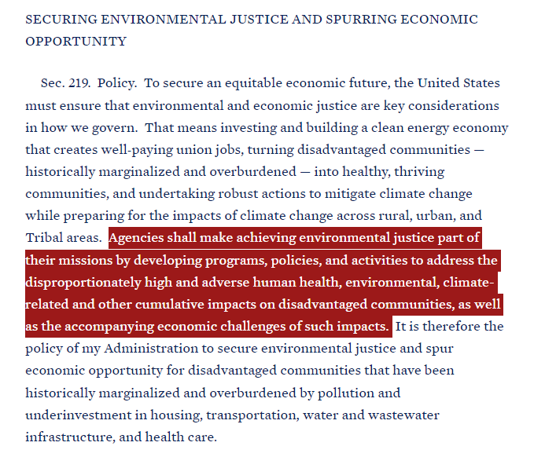
Environmental Justice Analysis as a Priority
Executive orders:
Executive order 12898
Executive order 14008
Signed January 2021

Slide 5
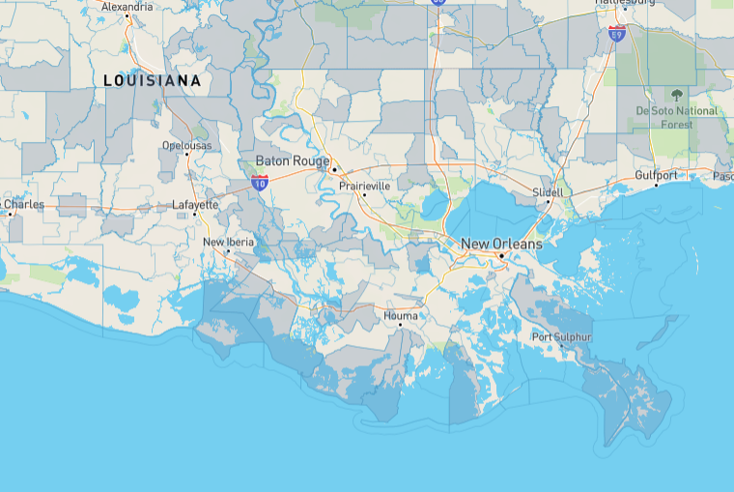
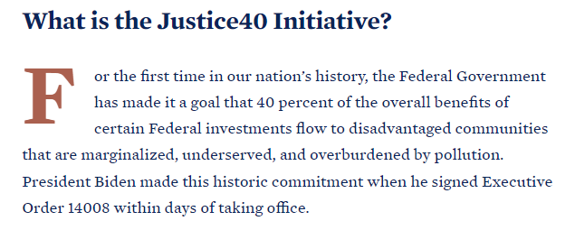
Justice40 Initiative
Figure: Disadvantaged communities in Southern Louisiana according to CEJST (link to tool).

Slide 6
What is an EJ Analysis?
An EJ analysis documents baseline conditions such as pre-existing exposure, cumulative impacts, and distribution of health impacts over population groups with heightened socioeconomic vulnerability.
An EJ analysis is distinct from distributional analysis:
Distributional analysis is an evaluation of incidence of benefits or costs by different members of society (often income quintiles)

Slide 7

Guidelines for EJ Analysis
EPA’s Technical Guidance for EJ Analysis:
Underwent extensive internal review by all program offices, public comment, and peer review by EPA’s Science Advisory Board.
Finalized in 2016 but never properly implemented.
Outlines approaches for risk assessors and economists to evaluate EJ concerns for significant policy actions
2022 Strategic Goal to have EJ Analyses in at least 80% of significant policy actions.

Slide 8
Goals of EJ Analysis
An EJ Analysis seeks to answer three questions:
Is there evidence of potential EJ concerns in the baseline for population groups of concern?
Do the regulatory option(s) under consideration affect the potential EJ concern?
Do the regulatory option(s) under consideration exacerbate or mitigate EJ concerns relative to the baseline?

Slide 9
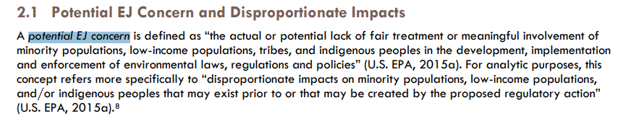
Key Terms: Potential EJ Concern
Procedural
Justice
Distributive
Justice

Slide 10
Key Terms: Vulnerability
“A matrix of physical, chemical, biological, social, and cultural factors that result in certain communities and subpopulations being more susceptible to environmental factors because of greater exposure to such factors or a compromised ability to cope with and/or recover from such exposure.”
Source: WHO (2006). Principles for Evaluating Health Risks in Children.

Slide 11
Key Terms: Groups of Concern
Groups of Concern
People of color: American Indian or Alaska Native, Asian, Black, Native Hawaiian and Pacific Islander, and Hispanic
Characteristics associated with vulnerability: low income, over age 65, under 5, women of child-bearing age, linguistic isolation, low educational attainment, subsistence fishers

Slide 12
Steps to an EJ Analysis
Early screening assessment:
Review availability of data and analytic methods
Evaluate literature and stakeholder input
Identify indicators of potential EJ concerns
Proximity, potential for hotspots, number of sources, nature and amounts of pollutants already impacting relevant populations, unique exposure pathways, unique vulnerabilities, etc.

Slide 13
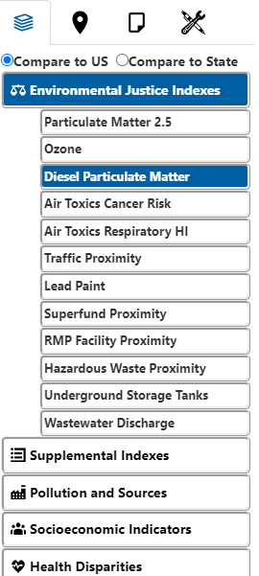
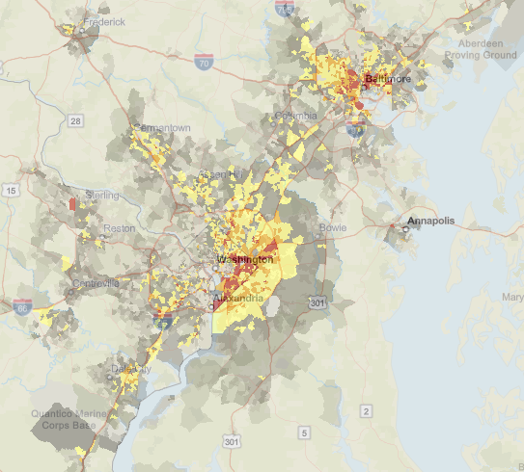
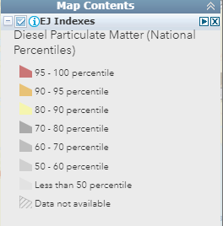
EJSCREEN version 2.0
Nationally consistent environmental and demographic data in maps
Block-group level data
State/national levels and percentiles as basis of comparison
Allows custom buffers, threshold maps, batch analyses
Indices to highlight the intersection between environmental and socioeconomic factors

Slide 14
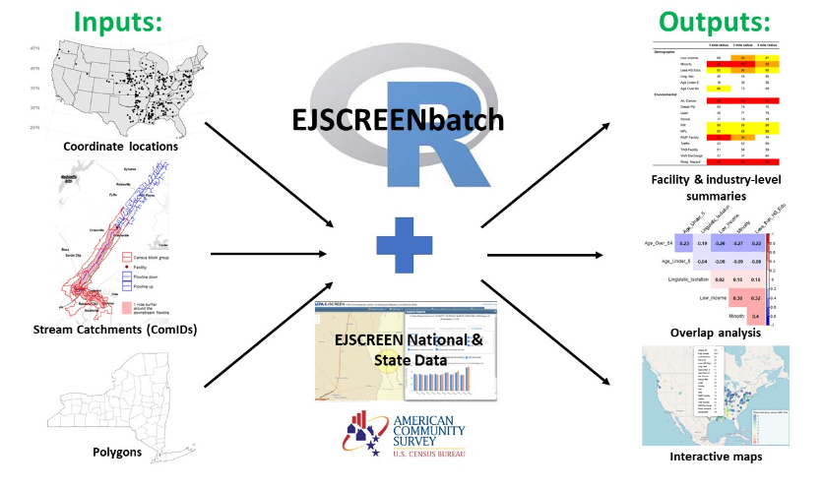
EJSCREENbatch
EJSCREENbatch is an open-source processing tool that allows inputting many locations and fetching aggregate EJSCREEN information and other demographic information.
Github repo.

Slide 15
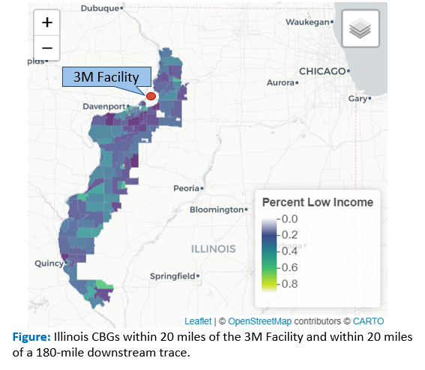
EJSCREENbatch: Example of 3M Plant in Cordova, Illinois
The 3M Specialty Film and Media Products Plant manufactures PFAS. According to NPDES DMR reports, it released:
26,000 kg of 10 unique PFAS, especially PFBA, over the period from 2018-2021.
A buffer approach for all tracts within 20-miles around the facility and a 180-mile distance downstream includes 282 CBGs with a population of 290,000.

Slide 16
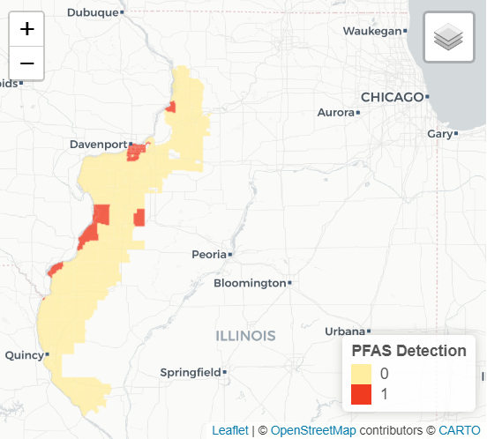
EJSCREENbatch: Example of 3M Plant in Cordova, Illinois
Service Boundaries can be used to screen across the 95 census block groups served by water systems with PFAS detections.
EJSCREEN Indicator | Average (Detect = 1) | Average (Detect =0) | State Average | National Average
Pct. Minority | 33.5 | 27.1 | 28.7 | 31.4
Pct. Low Income | 30.6 | 9.5 | 38.6 | 39.9
Pct. Linguistic Isolation | 2.5 | 0.6 | 4.8 | 5.4
PM 2.5 | 9.3 | 9.1 | 9.9 | 8.7
Traffic Proximity | 470.7 | 163.1 | 752.0 | 705.0
Pct pre-1960 Housing | 56.5 | 44.7 | 39.9 | 27.2
Population | 111,517 | 179,598
Figure: Illinois CBGs with a detection any of 12 PFAS from 2016-2021. Data source: Illinois Drinking Water Watch website

Slide 17
Other Steps in an EJ Analysis
4. More in-depth assessment if warranted and where possible:
Select relevant geographic scope, scale, and comparison groups
Capacity for more nuanced approaches dictated in part by ability to build from risk and benefits assessments
5. Pre-proposal community engagement:
Recent examples: oil & gas NPSPS, steam electric ELG, PFAS NPDWR

Slide 18
How EJ Analysis Informs Regulatory Design
Economic Efficiency and Impacts
Environmental Justice, Technical Feasibility, Enforcement
Political, Institutional, and Statutory
Preferred Alternative(s)
Political Factors
Statutory Instruction
Institutional Feasibility
Benefits and Costs (Economic Efficiency)
Environmental Justice
Economic Impacts (Distribution)
Technical Feasibility
Enforceability
Ethics
Sustainability
Possible Regulatory Designs/Stringencies

Slide 19
Part 2: Analytic Considerations

Slide 20
Common Pitfalls in Assessing EJ Concerns
Studies may miss or mis-characterize EJ concerns because of their analytic methods:
Defining the comparison group
Controlling (or not controlling) for other variables and multicollinearity
Transboundary pollution and measurement error
Unit-hazard coincidence vs. distance measures
Defining the unit of analysis and the ecological fallacy

Slide 21
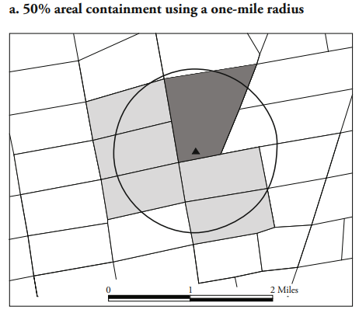
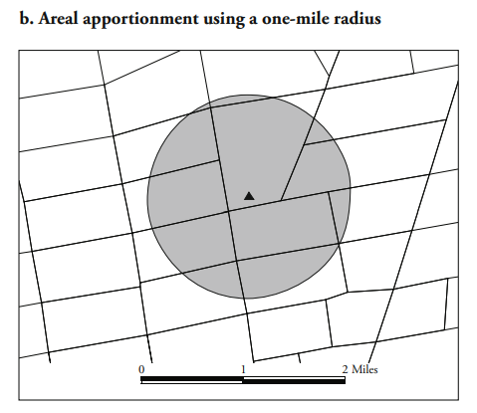
Mohai and Saha (2006)
Unit-hazard coincidence considers the demographics of one pre-determined boundary.
Distance-based measures consider demographics within a specified distance, often by areal apportionment.
Notes:
298 TSDFs, or 49% of those examined, are within 0.25 miles of the boundary of their host tracts, while 433, or 71%, are within 0.5 miles

Slide 22
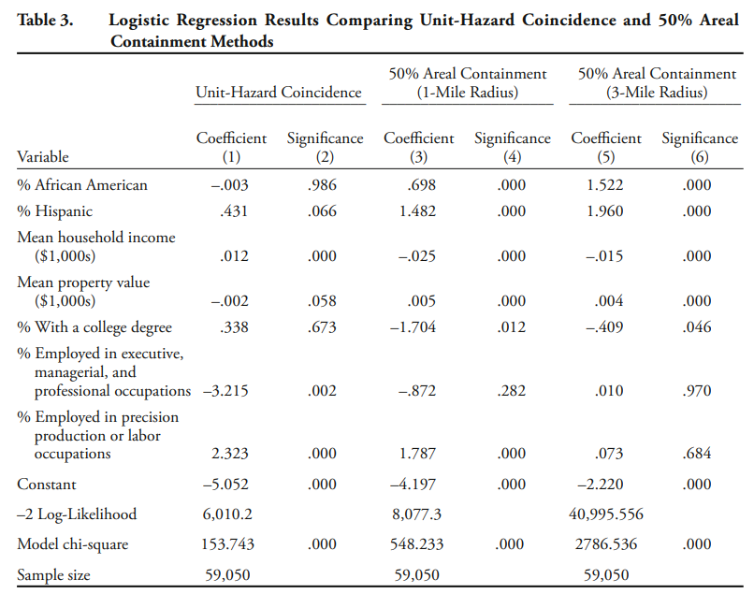
Mohai and
Saha (2006)
Race and income are more likely to be correlated with pollution when using distance-based measures rather than unit-hazard coincidence.

Slide 23
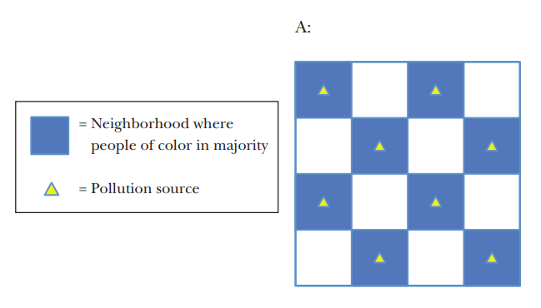
Ecological Fallacy
Unit of analysis
Ecological fallacy: Incorrectly drawing conclusions about individual exposures from group exposures.
In figure A, Pollution sources are perfectly correlated with neighborhoods where people of color are the majority.

Slide 24
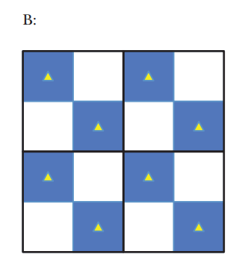
Ecological Fallacy
Unit of analysis
Using a larger group for analysis in figure B, there is no correlation between pollution sources and minority neighborhoods.

Slide 25
Ecological Fallacy
Aggregation can mask inequality of pollution exposure with greater residential segregation.
Baden, Noonan, and Turaga (2007) show using smaller level of analysis increases correlation between NPL sites and demographics.

Slide 26
Part 3: Example EJ Analysis

Slide 27
AIM Act
American Innovation and Manufacturing (AIM) Act to incentivize less use of hydroflourocarbons (HFCs), June 2022 version.
HFCs developed to replace ozone depleting substances
HFCs used in refrigeration, air conditioning, aerosols, fire suppression, and foam blowing sectors.
HFCs have global warming potential (GWP) hundreds to thousands of times greater than carbon dioxide

Slide 28
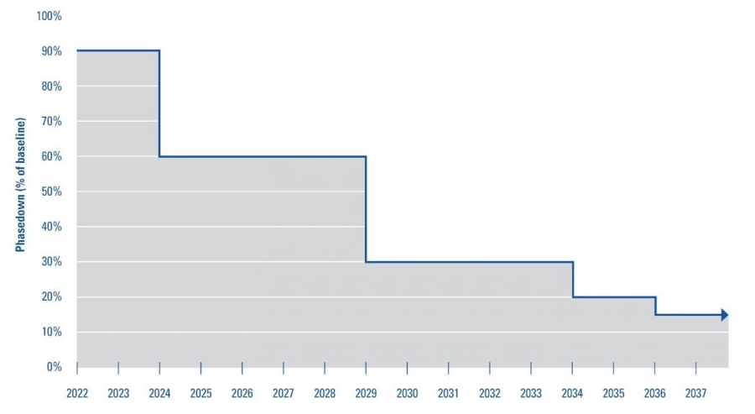
AIM Act
American Innovation and Manufacturing (AIM) Act to phase down use of hydroflourocarbons (HFCs):
Phase down schedule is based on allowances that can be traded.

Slide 29
AIM Act EJ Concerns
No local effects from direct exposure to HFCs
Potential EJ concerns about feedstocks, catalysts and byproducts of HFC production.
HFCs rely on toxic chemicals for production (e.g., carbon tetrachloride, hydrochloric acid, vinyl chloride, trichloroethylene (TCE), hydrogen fluoride)
Some lower GWP HFC alternatives also rely on toxic chemicals.

Slide 30
AIM Act EJ Analysis
Key Elements:
Describe possible health effects of feedstock chemicals and potential risk of exposure for workers
Present profile of toxic releases associated with HFC production at each facility overall and by chemical
Proximity analysis to examine nearby community characteristics and cumulative risk of exposure
Summarize recent compliance and enforcement history of HFC facilities

Slide 31
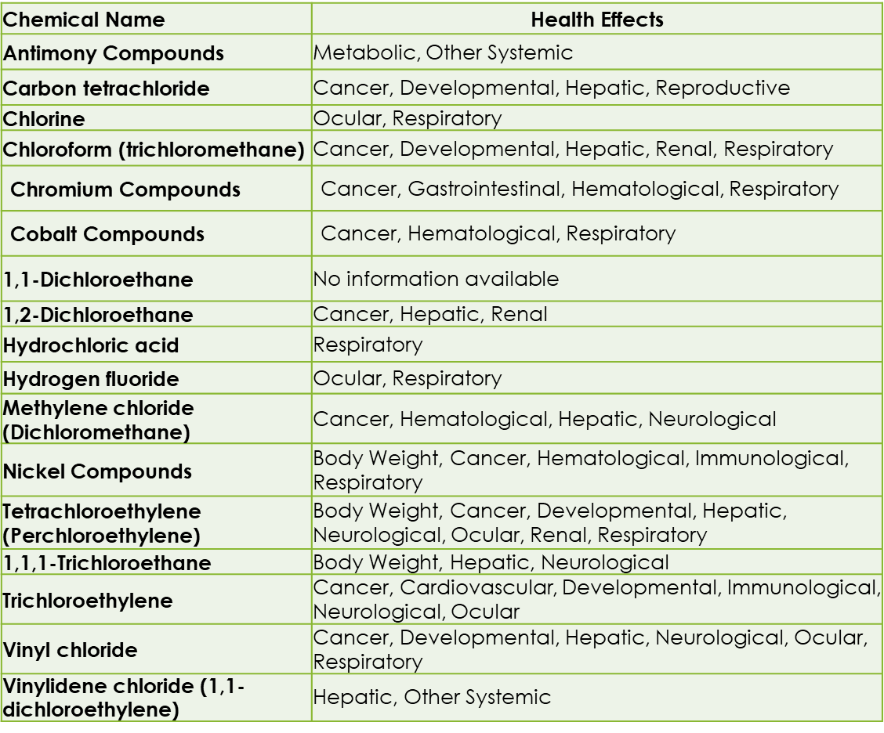
Health Effects of Byproducts or Feedstocks of HFC Production
HFC production uses chemical feedstocks and catalysts or produces byproducts that are toxic and/or may lead to serious health impacts for local communities and workers.

Slide 32
Evaluation of 8 HFC Facilities
Facility name | City | State | Number of Employees | 2019 HFC Emissions (MT CO2e) | Air releases of toxic HFC production chemicals | Water releases of toxic HFC production chemicals | Offsite transfers of toxic HFC production chemicals
Arkema, Inc. | Calvert City | Kentucky | 200 | 843,010 | 58,043 | 456 | 501
Chemours - Corpus Christi Plant | Gregory | Texas | 250 | 17,240 | 34,876
Chemours El Dorado | El Dorado | Arkansas | 21 | 66,990 | 9,868
Chemours Louisville | Louisville | Kentucky | 127 | 3,707,770 | 3,724 |  | 196
Daikin America | Decatur | Alabama | 200 | 5,297 | 3,313 | 22 | 30
Honeywell - Geismar Complex | Geismar | Louisiana | 250 | 413,584 | 51,282 | 499 | 62,543
Iofina Chemical Inc. | Covington | Kentucky | 100 | NR
Mexichem Fluor Inc. | Saint Gabriel | Louisiana | 67 | 18,331 | 4,369 | 28 | 73

Slide 33
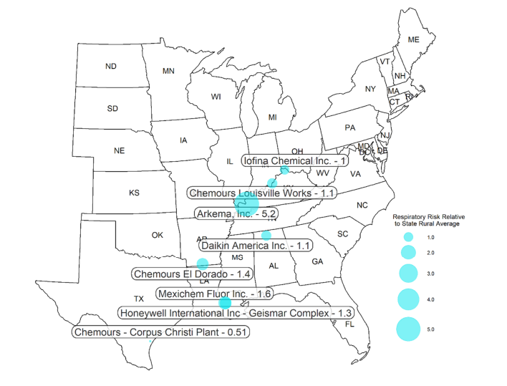
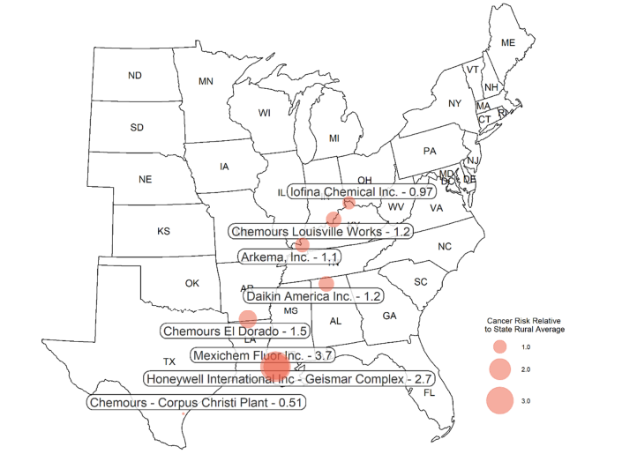
Evaluation of 8 HFC Facilities

Slide 34
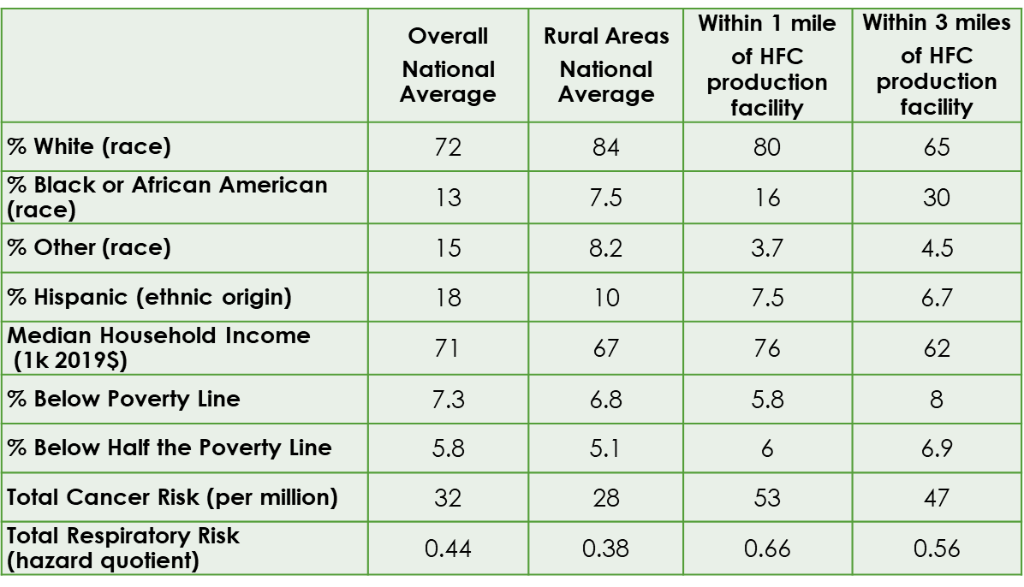
Community Profile Analysis of 8 HFC Facilities
Proximity analysis characterized communities near 8 HFC facilities.
1-, 3-, 5- and 10-mile buffers
Overall and for each facility
Very high NATA cancer risks around LA facilities
Not only due to HFC production

Slide 35
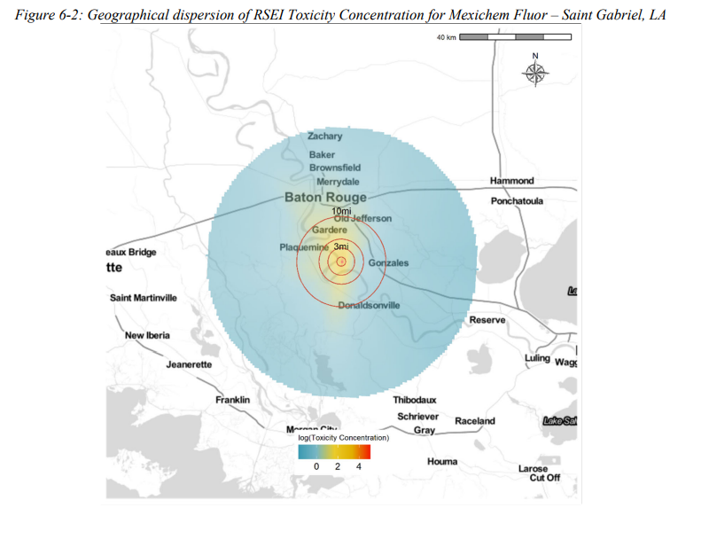
Facility Emissions Transport Modelling
Modelled pollution transport modelling for specific facilities with the highest respiratory hazard (link to Regulatory Impact Analysis).

Slide 36
AIM Act EJ Analysis Conclusions
Conclusions:
Baseline cancer and respiratory risks from air toxics are generally higher close to an HFC production facility
Higher percentages of low-income and Black individuals live near HFC production facilities compared with the overall average at the national level.
Potential changes in toxic emissions might be unevenly distributed in ways that impact low-income and minority communities differentially.
Predicting these effects ex ante is difficult due to limited information on where and in what quantities specific substitutes will be produced.

Slide 37
Part 4: Retrospective Studies of EJ Analysis

Slide 38
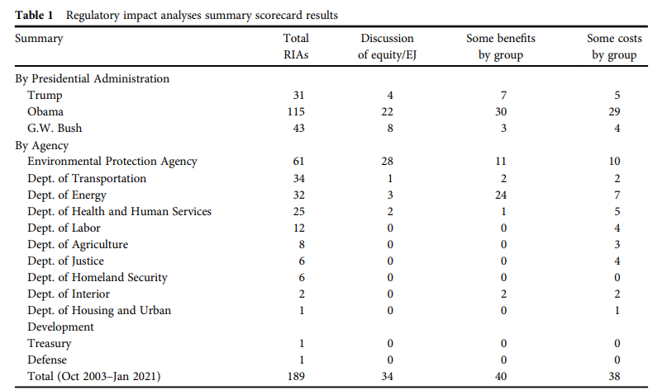
Some Perspective
In general, federal agencies have not conducted meaningful EJ analyses.
Cecot and Hahn (2022) analyze 189 regulatory impact assessments from 2003-2021.
17% of regulatory analyses discuss EJ and equity.
28 of 34 analyses that discussed equity or EJ were EPA analyses.

Slide 39
Quantitative EPA EJ Analyses 2012- 2021
EPA inventory of EJ analyses for economically significant final rules, Jan 2012 – Jan 2021.
More than half quantitatively evaluated potential EJ concerns
Majority only characterize baseline
Often rely on proximity analysis
Years | Total Final Rules | Total with EJ Analysis | Total with Quantitative EJ Analysis | Percent with Quantitative EJ Analysis
2012-14 | 11 | 6 | 5 | 45%
2015-17 | 12 | 11 | 7 | 58%
2018-21 | 11 | 9 | 6 | 55%
Total | 34 | 26 | 18 | 53%

Slide 40
Quantitative EJ Analyses 2012- 2021

Slide 41
Andarge et al. (2023)
Abstract: Since President Clinton’s Executive Order 12898, federal agencies have been required to conduct environmental justice (EJ) analyses of federal rules and regulations. More recently, the Biden Administration instituted several efforts to reform regulatory review and promote a more equitable distribution of environmental benefits and burdens. This paper seeks to understand how prior guidelines have been implemented in federal regulatory reviews related to the Clean Water Act and provide a baseline for future studies of the distributional effects of clean water regulations. We reviewed 18 regulatory impact assessments relating to the Clean Water Act conducted since 1992. Only five of these studies conducted a quantitative analysis of distributional impacts and none of the 18 assessments found disproportionately adverse effects on low-income or minority communities. Anticipating that future regulatory review will require more comprehensive distributional analyses, we combine national data on the location of regulated point sources with demographic characteristics to determine the baseline distribution of water pollution facilities. Overall, we find that discharge locations tend to be located in areas with higher poverty rates, higher White population shares, and less education. We find that rurality partly explains this pattern. We conclude with a discussion of the policy implications of these analyses.

Slide 42
Andarge et al. (2023)
Overview:
Summarize 18 EJ analyses in rules relating to the Clean Water Act since 1992.
Combine national information on wastewater discharge locations (“outfalls”) with demographic information to assess potential EJ concerns.
Provide new tools for assessing environmental justice concerns in the form of pseudo Lorenz curves.

Slide 43
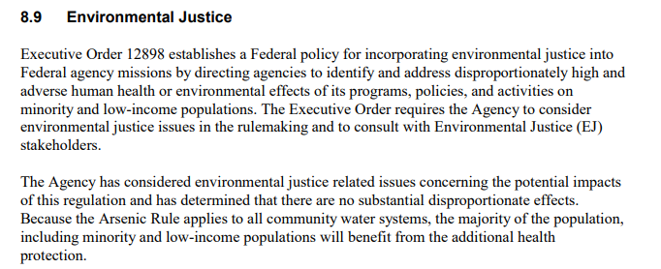
Andarge et al. (2023)
Review of 18 prior EJ analyses:
Only five conducted a quantitative EJ analysis.
Many rules argued that because the rule improves environmental conditions, no EJ analysis is necessary.
Analyses typically only look at % low income and % minority.
No EJ analysis found disproportionately high or adverse human health or environmental effects on minority or low-income populations.
EJ analysis in the 2001 arsenic drinking water rule.

Slide 44
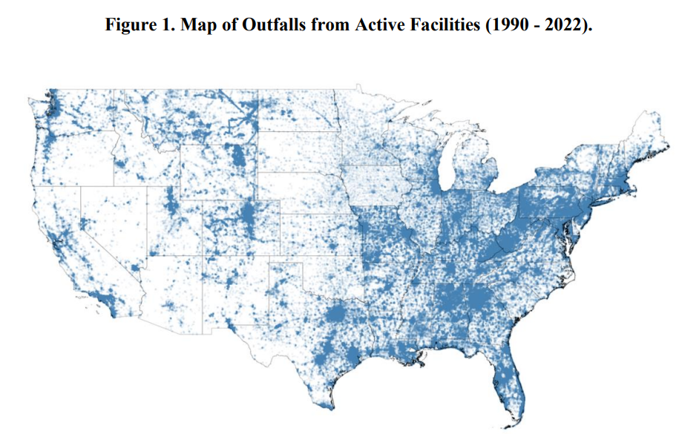
Andarge et al. (2023)
Assess how outfall locations may impact various communities. Communities near outfalls are more likely to have a greater share of the population that is:
Non-Hispanic White
Below the poverty line
Less than college degree education
Most outfalls are in rural regions
Suggest importance of separating rural and national analyses.
Image: All outfalls included in the analysis.

Slide 45
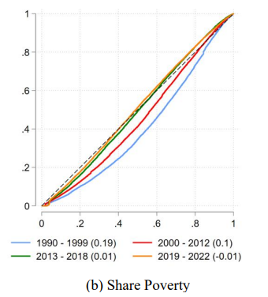
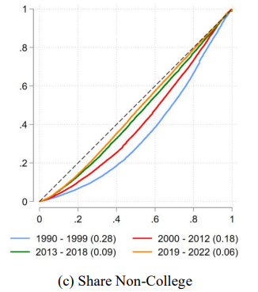
Andarge et al. (2023)
Pseudo-Lorenz curves as a contribution to EJ methods.
Note the Gini coefficient, a measure of inequality, is 2X is the area between 45 degrees and the Lorenz curve.
Notes:
For the curious, all values on the x and y axis are normalized to be between 0 and 1.
Normalizing a variable x requires manipulating all values to be (x – min(x)) / (max(x) – min(x)). In words, the minimum value is subtracted from the observation, and then this term is divided by the range of the variable. To normalize values to be 0-100, just multiply the whole term by 100.

Slide 46
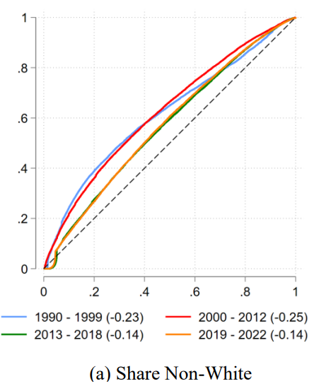
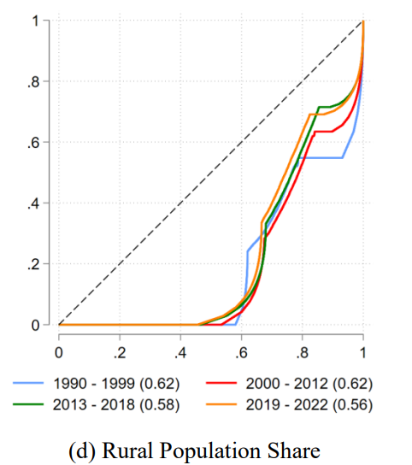
Andarge et al. (2023)
Some odd-looking Lorenz curves.
What’s going on here?

Slide 47
Next class
Have a nice weekend. Your third case study is due October 29th. It is a simple coding assignment, but some might have issues downloading the requisite R packages. Let me or Yagmur know if you’re facing difficulty with the script.
Next Monday Professor Theising will review content for the midterm on Wednesday, October 18th.

